Slide 1
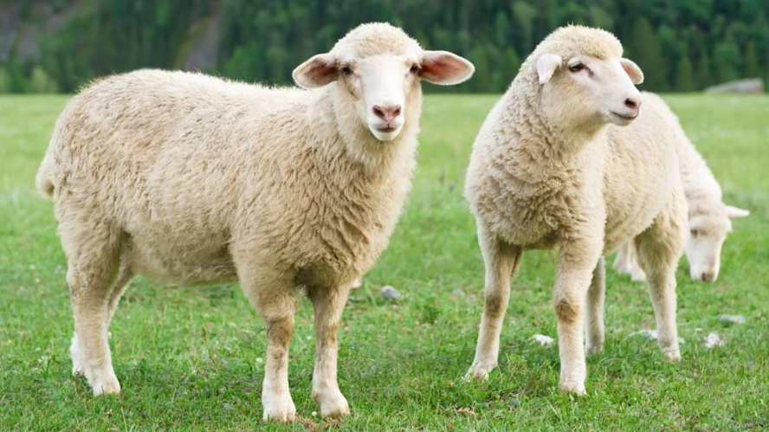

Sheep
Sheep are members of the order Artiodactyla, the even-toed ungulates.
Scientific name: Ovis aries
Gestation period: 152 days
Lifespan: 10 – 12 years
Rank: Species
Mass: Male: 45 – 160 kg (Adult), Female: 45 – 100 kg (Adult)
Sheep are herbivores that eat vegetation such as grass.

Slide 2
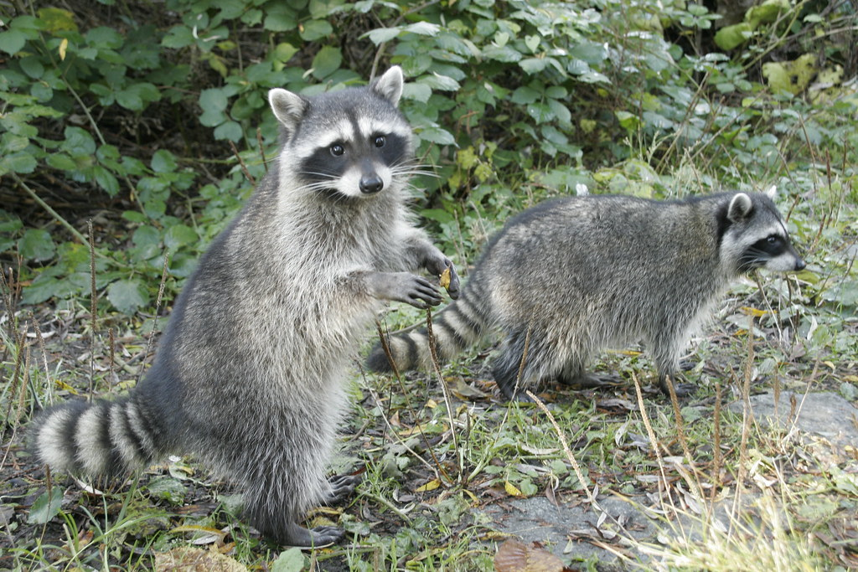
Raccoon
Scientific name: Procyon lotor
The largest of the procyonid family
Lifespan: 2 – 3 years (In the wild)
Trophic level: Omnivorous Encyclopedia of Life
Mass: 3.5 – 9 kg (Adult)
Speed: 16 – 24 km/h
Did you know: Raccoons possess acute senses of sight and hearing and a highly developed sense of touch.

Slide 3
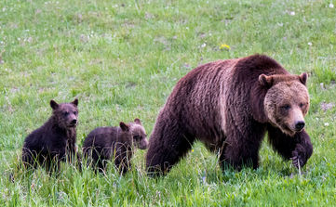
Bear
Scientific name: Ursidae
Speed: Polar bear: 40 km/h
Lifespan: Giant panda: 20 years
Mass: Giant panda: 70 – 100 kg, Polar bear: 450 kg
Height: Giant panda: 60 – 90 cm, Polar bear: 1.8 – 2.4 m, Brown bear: 70 – 150 cm
Did you know: Even still, bears live a lot longer in captivity than they do in the wild.

Slide 4
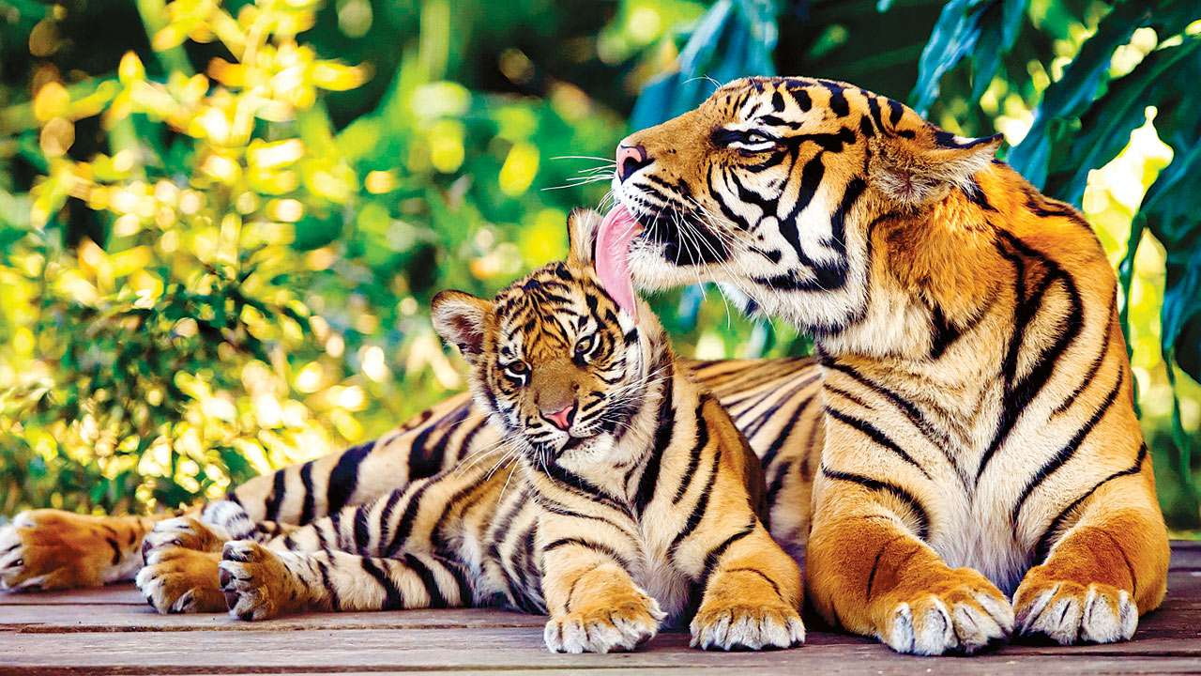
Tiger
Scientific name: Panthera tigris
Conservation status: Endangered
Family: Felidae
Lifespan: 16 – 18 years (In captivity)
Diet: Carnivore - Primarily preying on ungulates such as deer and wild boar.
Did you know: In several Chinese arts, Tiger is depicted as the symbol of earth and equal rival of the Chinese dragon.

Slide 5
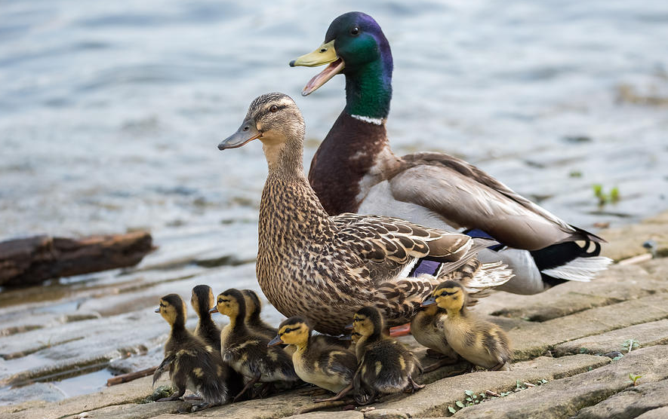
Duck
From waterfowl family Anatidae which also includes swans and geese.
Lifespan: Mallard: 5 – 10 years
Clutch size: Mallard: 8 – 13
Phylum: Chordata
Wingspan: Mallard: 81 – 98 cm
Mass: Mallard: 0.72 – 1.6 kg, Canvasback: 1.2 kg, Marbled duck: 480 g
Length: Mallard: 50 – 65 cm, Canvasback: 48 – 56 cm

Slide 6
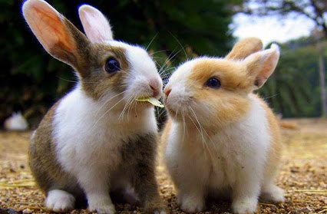
Rabbit
From Leporidae of the order Lagomorpha. Oryctolagus cuniculus includes the European rabbit species and its descendants, the world's 305 breeds of domestic rabbit. Sylvilagus includes 13 wild rabbit species, among them the 7 types of cottontail.
Lifespan: 1 – 2 years (In the wild)
Daily sleep: 8.4 hours (Adult, In captivity)
Phylum: Chordata

Slide 7
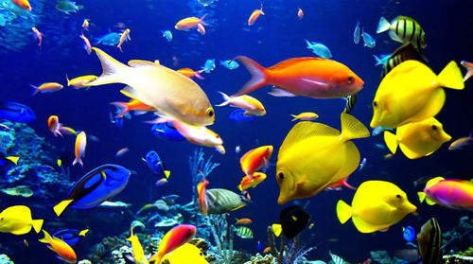
Fish
Phylum: Chordate
Fish are vertebrate animals that live in the water. Vertebrate means they have a spinal cord surrounded by bone or cartilage.
Fish have gills that extract oxygen from the water around them.
There are over 30000 known species of fish.
Over 1000 fish species are threatened by extinction.

Slide 8
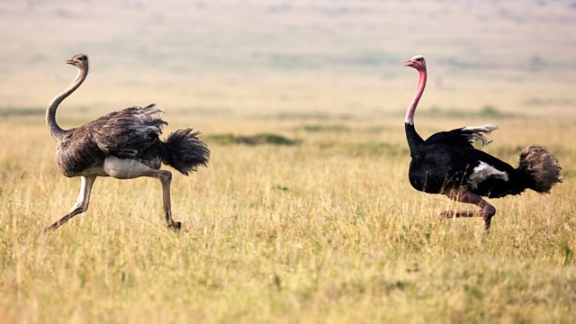
Ostrich
A species of large flightless bird. It is one of two extant species of ostriches, the only living members of the genus Struthio in the ratite order of birds.
Scientific name: Struthio camelus
Speed: 70 km/h (Maximum, Adult, Running)
Height: Male: 2.1 – 2.8 m (Adult), Female: 1.7 – 2 m (Adult)
Mass: Male: 120 kg, Female: 100 kg
Did you know: The ostrich swallows pebbles and sand to aid the digestive process.

Slide 9
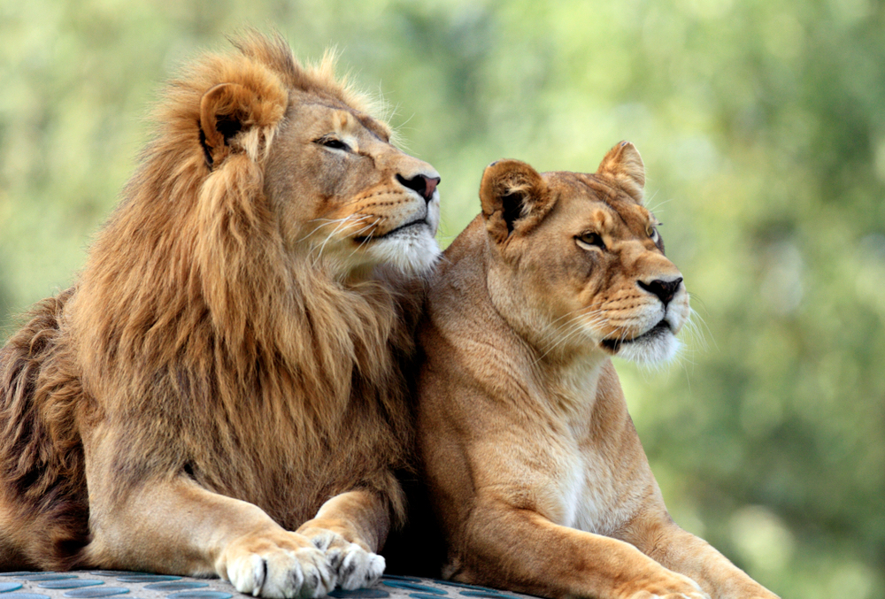
Lion
Scientific name: Panthera leo
Lifespan: 10 – 14 years (Adult, In the wild)
Conservation status: Vulnerable (Population decreasing)
Diet: Carnivore
Mass: Male: 190 kg (Adult), Female: 130 kg (Adult)
Did you know: Lions once roamed most of Africa and into parts of Asia and Europe.

Slide 10
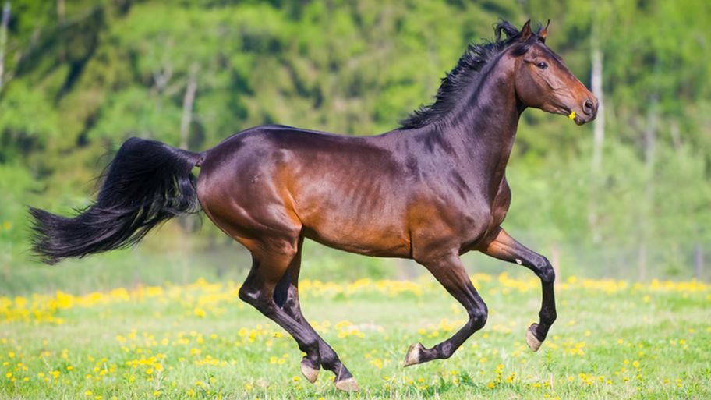
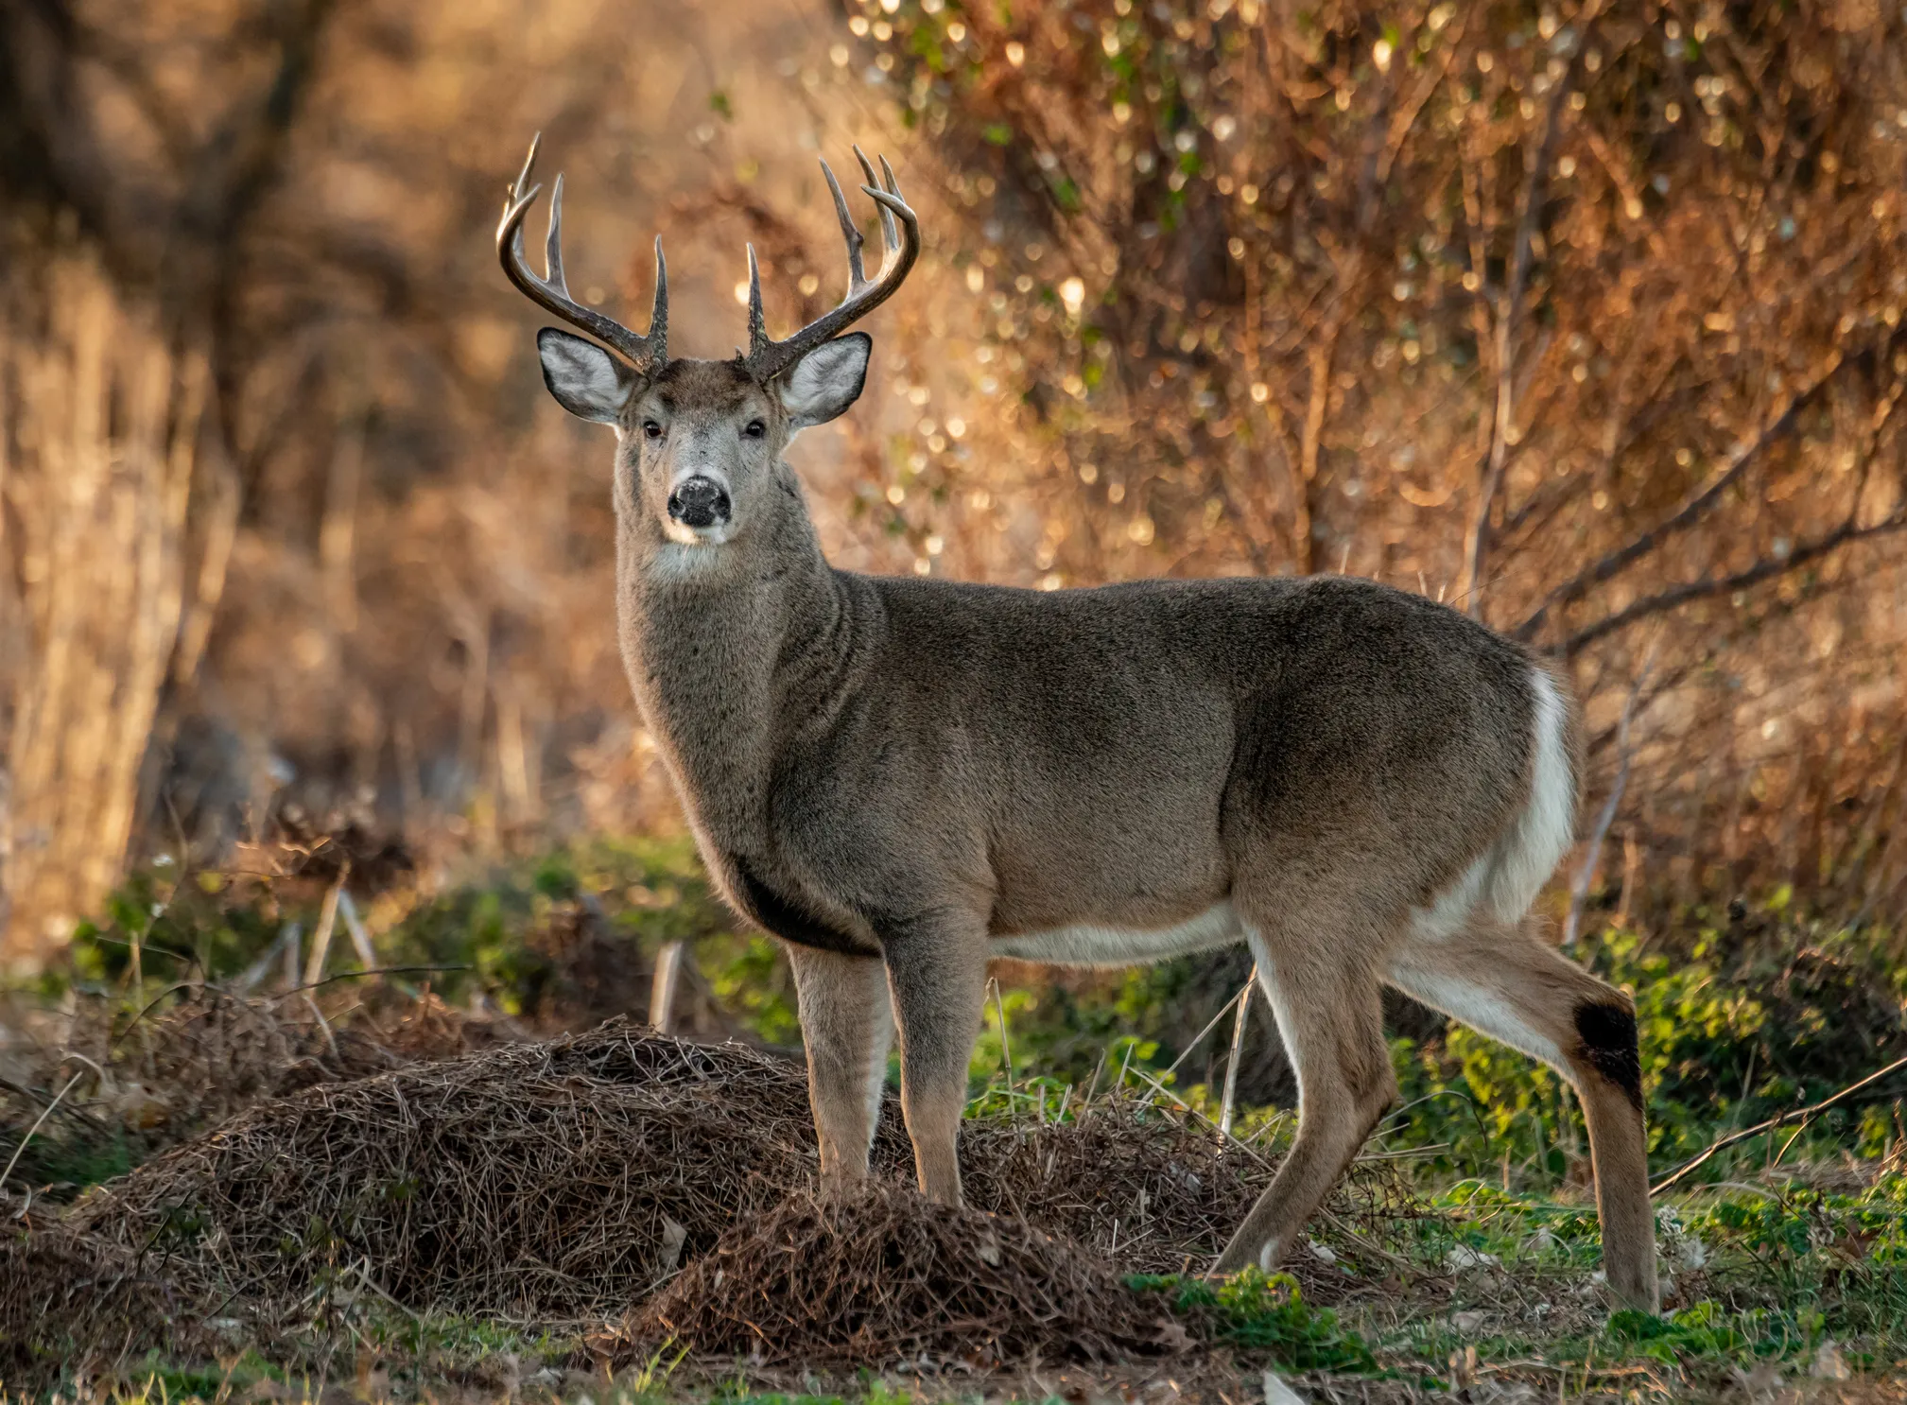
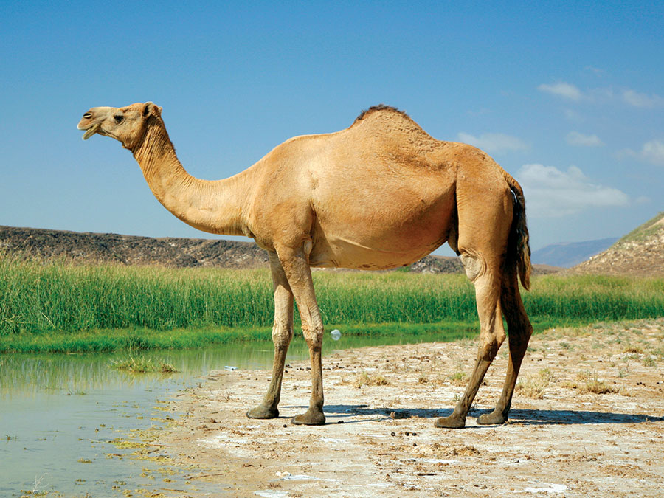
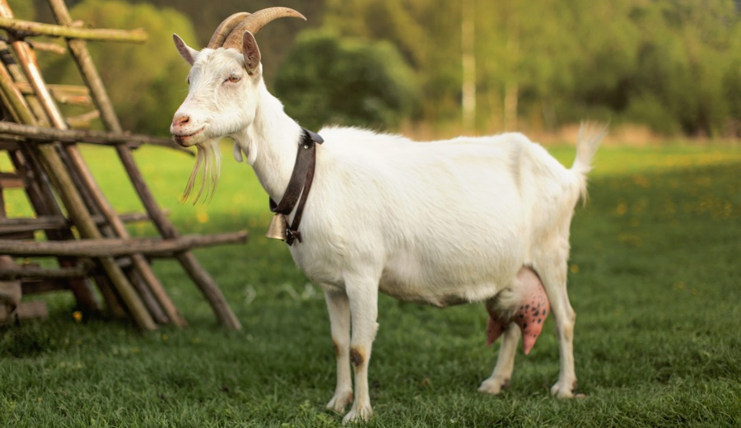
Lion
Horse
Deer
Camel
Goat

Slide 11
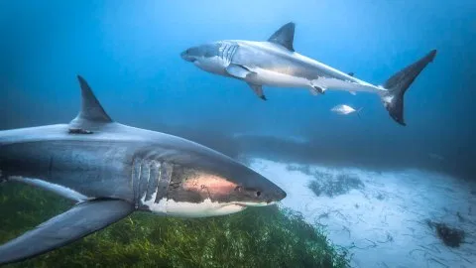
Shark
Sharks are a group of elasmobranch fish characterized by a cartilaginous skeleton, five to seven gill slits on the sides of the head, and pectoral fins that are not fused to the head.
Lifespan: 20 – 30 years (In the wild)
Scientific name: Selachimorpha
Class: Chondrichthyes
Kingdom: Animalia
Speed: 50 km/h (Maximum, Adult, In The Water, In Short Bursts)
Phylum: Chordata

Slide 12
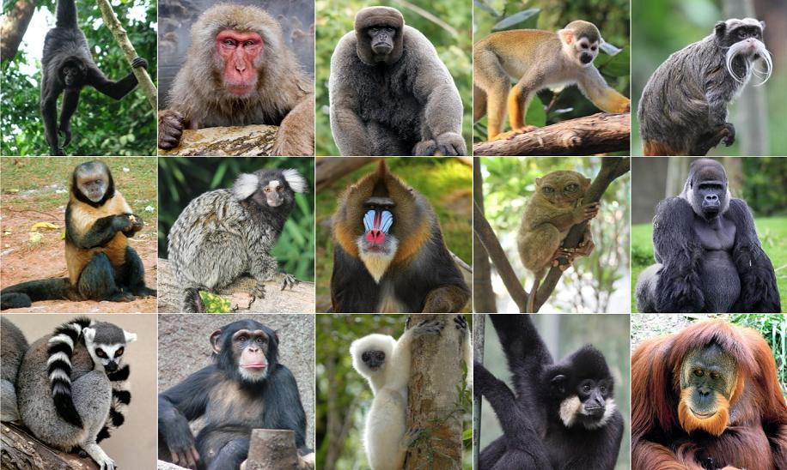
Monkey
Monkey is a common name that may refer to groups or species of mammals, in part, the simians of infraorder Simiiformes. The term is applied descriptively to groups of primates, such as families of New World monkeys and Old World monkeys.
Different monkey species eat a variety of foods, such as fruit, insects, flowers, leaves and reptiles.
There are currently 264 known monkey species.

